Slide 1
Statistical Thinking and Data Science
Deborah Nolan
University of California, Berkeley

Slide 2
Goal
Integrate computational thinking into statistics
Abstraction
Algorithmic thinking
Use computing expressively to:
Construct statistical understanding
Conduct data analysis

Slide 3
Simulation Studies
Develop probability models for our data
Compare variability in our data and statistics to benchmarks
Check appropriateness of assumptions

Slide 4
Statistical Graphs
Choose plots appropriate for the data
Basic statistics literacy
Variability
Data reduction & smoothing
Method of comparison
Confounding
Notes:
Computationally intensive methods, e.g.,
Classification trees, spline smoothing

Slide 5
Bootstrap & Resampling
Emphasize the probability model behind hypothesis testing
Convey variability in sampling distributions and confidence intervals

Slide 6
Empirical Risk Formulation
Point estimation
Prediction and Inference
Test-Train split paradigm
Model selection
Variance-Bias trade off

Slide 7
Data Life Cycle
Context question → Answerable question
What to do about model → ← data disagreements
How to assess and draw conclusions

Slide 8
Our Students Gain –
Exposure to statistical thinking in a different environment
Technical skills to engage in collaborative problem solving
Confidence to overcome computational challenges to carry out a comprehensive data analysis
Ability to communicate through code

Slide 9
Today’s Agenda
Mixture of presentations, live coding, individual exercises & practice
Topics
R – introduction to computing
Simulation and testing
Visualization and ggplot
Bootstrapping
Data Life Cycle

Slide 10
Today’s Materials
https://debnolan.github.io/TeachingDataScience/
Agenda
Exercises and Demo Notebooks
Slides
RStudio cloud session link

Slide 11
Teaching Computational Concepts in Statistics

Slide 12

Why ?
High-level scripting language
Statistical programming language
Interactive exploratory data analysis
Allows custom analysis
Easy to replicate analysis
Sound numerical methods
Large Community of contributors

Slide 13
Critical point in statistics
Computing is becoming increasingly vital part of statistical in this era of:
Ubiquitous data availability & sources
Increased volume & complexity of data
Increased relevance of data analysis in all fields, done by non-statisticians
Communicating results in new ways
Notes:
We are at a very important point in statistics and stat. education because of the Web and its technologies. These are sources of data, and ways to communicate results of statistical analyses, and technologies that we have to use to collaborate with other scientists. So we have to embrace these and master them so that we can play an important role in data-centered sciences. Otherwise, as we have seen in the past, other fields will fill the void we leave in not being able to actually carry statistical analysis through the data pipeline, from start to finish. It is not enough to say we know the best answer, but we don’t know anything about implementing it, delivering it, scaling it, …

Slide 14
New 1-unit (1/3) course in Programming
Wk | Topic | Reading | Lab/Quiz | HW Due
1 | REPL model & Call expressions | Ch 1 & 2 | Install R
2 | Data types and vectors | Ch 3 | Lab #1 | HW #1
3 | Data frames & reading text files | Ch 4 & 5 | Quiz #1
4 | Graphics - ggplot | Ch 6 | Lab #2 | HW #2
5 | Graphics - ggplot | Ch 6 | Lab #3
6 | Reshaping data |  | Quiz #2 | HW #3
7 | Reshaping data |  | Lab #4
8 | Other data structures & subsets |  | Lab #5 | HW #4
9 | Writing simple functions |  | Quiz #3
10 | Conditionally invoking code |  | Lab #6 | HW #5
11 | Iterative evaluation of code |  | Lab #7
12 | Formula language |  | Quiz #4 | HW #6
13 | Case Study |  |  | HW #7

Slide 15
Introductory Topics in R
Beginning
Expressions
REPL
Variable as vector:
Vector operations
Data types
Missing values
Data frames:
Table as a data frame
Simple subsetting

Slide 16
Introductory Topics in R
Functions
Arguments
Return – aggregator, vector of same length, other object
Graphics
Simple Monte Carlo simulation
Selecting random subsets
Repeating this process

Slide 17
RStudio

Slide 18
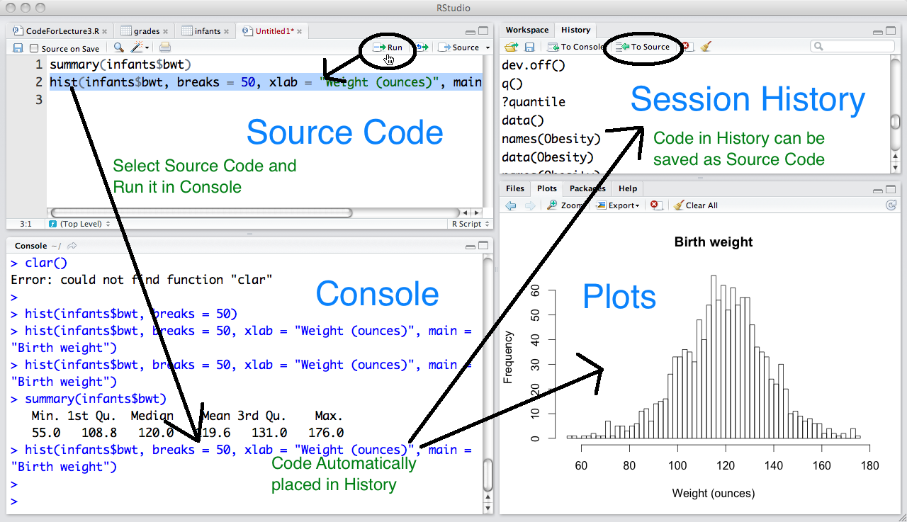
RStudio Environment

Slide 19
Getting Started
Let’s Try It
https://debnolan.github.io/TeachingDataScience/
Login: your email address
Password: correcthorsebatterystaple

Slide 20
Computing Concepts
Interactive language that facilitates exploratory data analysis
REPL
Copying semantics
Assignment
Store values so no need to re-compute
Write general expressions
Reduce redundancy (and mistakes)

Slide 21
Computing Concepts
Expressions
Arithmetic
Call (AKA function-style)
Functions
function signature
complex return values
applying functions to multiple objects

Slide 22
Vectors and Data Types

Slide 23
Data Analyst’s perspective
Think in terms of variables – an ordered collection of measurements on a group of subjects
Care about the sorts of values: it informs the type of analysis we might perform, e.g., we compute a mean of numeric values, but not categorical values
Care about missing data – we adjust our analyses depending on the amount and kind of missingness

Slide 24
Variable
A variable contains measurements, e.g., monthly maximum temperature in Port Elizabeth
> maxTemp
[1] 25 25 24 23 21 20 19 19 20 20 22 24
We call a variable in R a vector
They are ordered containers.
There are 12 values in maxTemp the first is 25 and 12th is 24

Slide 25
Vectors
We have monthly weather data for Port Elizabeth:
min and max temperature
precipitation
at least 8 hours of sunshine a day
swimming comfort level
name of the month
To follow along, from the online RStudio open
Ex1-DataTypesAndVectors.Rmd
Or download the exercise and open locally in RStudio

Slide 26
Vector
maxTemp
A vector is an ordered container of a set of values/measurements
The values must be all the same type of information
25
25
24
23
21
20
19
19
20
20
22
24

Slide 27
Vector Calculations
maxTemp
Convert temperature from Celsius to Farenheit
Formula:
F = C x 9/5 + 32
Elementwise calculation
25
25
24
23
21
20
19
19
20
20
22
24
* 5/9 + 32

Slide 28
Data Types
R has a number of built-in data types.
Three basic types:
numeric,
character, and
logical.
> class(precip)
[1] "numeric"
> class(mon)
[1] "character"
> class(sun8)
[1] "logical"
Notes:
logical vector - either TRUE or FALSE- these are special built-in objects in R

Slide 29
Months and Sunshine
> mon
[1] "Jan" "Feb" "Mar" "Apr" "May" "Jun" "Jul" "Aug"
[9] "Sep" "Oct" "Nov" "Dec“
> class(mon)
[1] "character"
> sun8
[1] TRUE FALSE FALSE FALSE FALSE FALSE FALSE
[8] FALSE FALSE FALSE TRUE TRUE
> class(sun8)
[1] "logical"

Slide 30
Swimming
> swim
[1] warm warm cool cool cool cool
[7] bracing bracing bracing bracing cool cool
Levels: bracing cool warm
> class(swim)
[1] "factor"
A factor vector is a special storage class used for qualitative data.
The values are internally stored as integers by each integer corresponds to a level, which is a character string

Slide 31
Special Values
Missing value:
symbol in R is NA for “Not Available”
Empty vector:
Symbol is NULL
Unusual numeric calculation:
NaN, for “not a number,” typically arises when compute something like 0/0
Inf or -Inf.

Slide 32
Data Frames
load(url('http://www.stat.berkeley.edu/users/nolan/data/family.rda'))
Or load('./data/family.rda')

Slide 33
The Family
We have all sorts of information about the members of a family: height, weight, first name, gender, …
The data frame gives us a way to collect all of these variables (vectors) into one object.

Slide 34
> family
firstName sex age height weight bmi overWt
1 Tom m 77 70 175 25.16239 TRUE
2 Maya f 33 64 124 21.50106 FALSE
3 Joe m 79 73 185 24.45884 FALSE
4 Robert m 47 67 156 24.48414 FALSE
5 Sue f 27 61 98 18.51492 FALSE
6 Liz f 33 68 190 28.94981 TRUE
7 Jon m 67 68 185 28.18797 TRUE
8 Sally f 52 65 124 20.67783 FALSE
9 Tim m 59 68 175 26.66430 TRUE
10 Tom m 27 71 215 30.04911 TRUE
11 Ann f 55 67 166 26.05364 TRUE
12 Dan m 24 66 140 22.64384 FALSE
13 Art m 46 66 150 24.26126 FALSE
14 Zoe f 48 62 125 22.91060 FALSE

Slide 35
Data Frame
The data frame gives us a way to collect all of these variables (vectors) into one object.
Tom
77
m
TRUE

Slide 36
Data Frame
family
Ordered container of vectors
Vectors must all be the same length
Vectors in a data frame can be different types
Tom
77
m
TRUE

Slide 37
Access a vector: dataframe$vector
> family$sex
[1] m f m m f f m f m m f m m f
Levels: m f
> mean(family$height)
[1] 66.857
> class(family$height)
[1] "numeric"

Slide 38
Logical Operations & Boolean Algebra

Slide 39
Data Analyst’s perspective
Care about examining subsets for making comparisons between groups
Many ways to subset
Logical expressions
Compare groups in visualizations
Apply summary statistics to groups

Slide 40
Logical/Relational Operators
Vectorized Operators
>, <, >=, <=, !=, and ==
> maxTemp > 22
[1] TRUE TRUE TRUE TRUE FALSE FALSE FALSE …
> swim == "warm"
[1] TRUE TRUE FALSE FALSE FALSE FALSE …

Slide 41
Boolean Algebra
Three operations: “not” “or” “and”
! is for not,
& is for and
| is for or
> sun8 | (swim == "warm")
[1] TRUE TRUE FALSE FALSE FALSE FALSE FALSE …
> maxTemp < 22 & precip > 20
Jan Feb Mar Apr May Jun Jul Aug Sep
FALSE FALSE FALSE FALSE TRUE TRUE TRUE TRUE TRUE

Slide 42
Examples
Under 50
Women
Not over weight
Males under 70 in tall
family$age < 50
family$sex == “f”
!family$overWt
(family$sex == “m”) &(family$height < 70)

Slide 43
Subsets of Data Frames with dplyr
library(dplyr)
require(dplyr)

Slide 44
Function for subsetting data frames
Rows
Logical: filter
Position: slice
Exclusion: slice
Columns
Position: select
Exclusion: select
Name: select
Other useful functions:
mutate
transmute
group_by and summarize

Slide 45
Examples of Subsets
Those who are not over weight
filter(family, !overWt)
Age and Weight of all in the family
select(family, weight, age)
select(family, c("weight", "age"))
Age and Weight of those not over weight
select(filter(family,!overWt), age, weight)

Slide 46
Functions

Slide 47
Data Analyst’s perspective
Aggregator: Want to summarize a variable
Vector-Vector: Want to transform a variable or combine variables
Other Object: Want several pieces of information from an analysis
Side-effect: Want to visualize relationships between variables

Slide 48
Examples
Aggregator: any(sun8) all(sun8)
Vector-Vector:
bmi = wt/ht^2
abs(minTemp - maxTemp)
Other Object: summary(sun8)
Side-effect:
save(subfamily, file = “adf.rda”)
plot(precip)

Slide 49
Example
Suppose we want to take a sample of 3 people from family.
Is there a function in R to do this?
How do we find it?
How do we call it?

Slide 50
How to find it?
Use Google search
I find searches like the following helpful
R random sample
R has built-in search help.search(“topic”)
Stacked Overflow is a good resource

Slide 51
How to call sample
We can find out the arguments to sample:
> args(sample)
function (x, size, replace = FALSE, prob = NULL)
We see it has 4 arguments: x, size, replace and prob
replace and prob are optional – they have default values (FALSE and NULL, respectively)
x and size must be specified – they have no default
We can learn more with the help function:
> ?sample
> help(“sample”)

Slide 52
Sample 3 names at random from family
First, we generate 3 values between 0 and 1.
sample(family$name, size = 3)
Arguments can be identified by position:
sample(family$name, 3, TRUE) – be careful, it can be hard to spot and error
Arguments can be identified by name:
sample(family$name, size = 3, replace = TRUE) – much better, don’t need to know ordering of arguments in function signature

Slide 53
Reading data into R
In the introductory class, most data is given to the students in R format, i.e., in an .Rda file
Students simply load the data into R with
load("family.rda")
OR
load(url("http://www...data/family.rda"))

